Slide 1
Introduction to Machine Learning
Short Course at Goldsmiths University

Slide 2
Welcome
Start (if not done already) to download anaconda. ... https://www.anaconda.com/download/

Slide 3
Content of the 10 lessons
Tools (python pandas scikit-learn data visualisation machine learning theory)
KNN algorithm
Linear model
Naive Bayes
Decision Tree and Random Forest
K-means
Preprocessing and features engineering
Neural Network

Slide 4
Machine Learning Definition
The whole concept of machine learning is figuring out ways in which we can teach a computer to perform a task without needing to provide explicit instructions.

Slide 5
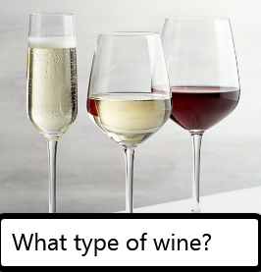
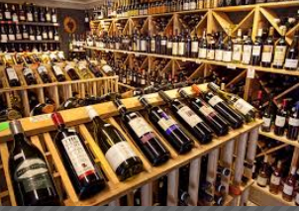
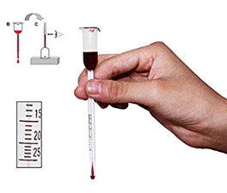
Example
Alcohol % | color | Label
12 | red | barbera
11 | white | Pinot grigio
14 | rose’ | spumante

Slide 6
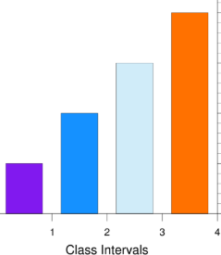
Data Analysis
Alcohol % | color | Label
12 | red | barbera
11 | white | Pinot grigio
.. | .. | ..
.. | .. | ..
.. | .. | ..
.. | .. | ..
14 | red | Barolo
14 | rose’ | spumante
For example: we collected 640 observations of wine bottles from the wine shop

Slide 7
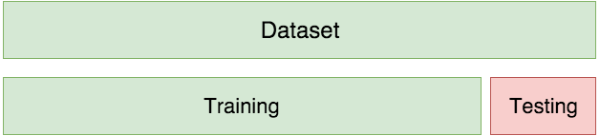
Training and testing
For example: we collected 640 observations of wine bottles from the wine shop
We train the model on 420 samples
We test on 220

Slide 8

We can then use the model on new (not labeled) data point to predict the label
Alcohol % | color | Label
12 | red
MODEL (trained)

Slide 9
Machine Learning - compared to traditional programming
Rules
Traditional Programming
Answers
Data
Answers
Machine Learning
Rules
Data

Slide 10
Example of solving a task with traditional programming
If the word “Free” in email: the is email is SPAM
Traditional Programming
Rules
Answers
Spam or Not Spam
emails
Data

Slide 11
Example of solving a task with Machine Learning
Spam or Not Spam
Machine Learning
Answers
Rules
The model has learned that If the word “Free” in email: the is email is SPAM
emails
Data

Slide 12
Use the Machine Learning model
Machine Learning
Answers
emails
Spam or Not Spam
Data
The model has learned that If the word “Free” in email: the is email is SPAM

Slide 13
Issues with hand coded rules - solved by machine learning
The logic required to make a decision is specific to a single domain and task. Changing the task even slightly might require a rewrite of the whole system.
Designing rules requires a deep understanding of how a decision should be made by a human expert.

Slide 14
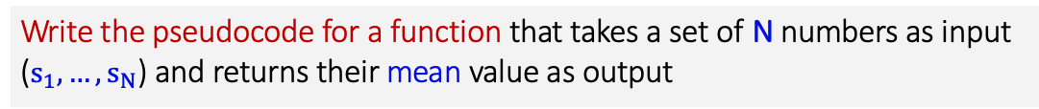
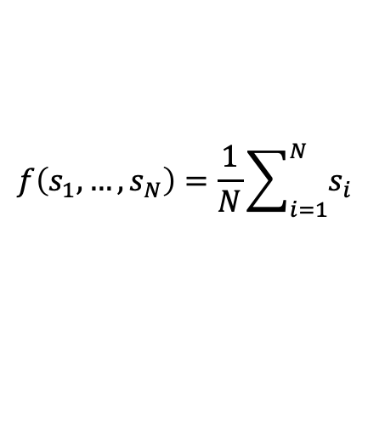
Why ML? Example 1
Write the pseudocode for a function that takes a set of N numbers as input ($s_{1},…,s_{N}$) and returns their mean value as output
A possible answer:
returnMean(s₁, …, s_{N}):
return sum(s₁, …, s_{N})/N
We can write code because we can analytically express the function:
$$f\left(s_{1},…,s_{N}\right)=\frac{1}{N}\sum_{i=1}^{N}{s_{i}}$$

Slide 15
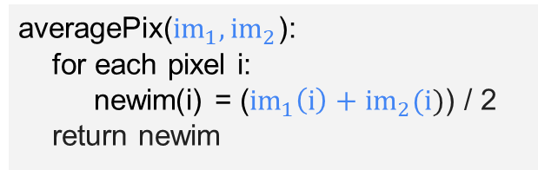
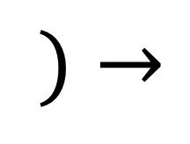
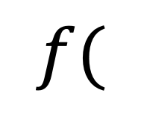

Why ML? Example 2
Write the pseudocode for a function that takes two images as input and returns an image with the average pixel intensities
$$f($$
$$)→$$
$$,$$
averagePix(${im}_{1},{im}_{2}$):
for each pixel i:
newim(i) = (${im}_{1}\left(i\right)+{im}_{2}(i)$) / 2
return newim
Again, this is possible because the function can be expressed analytically

Slide 16
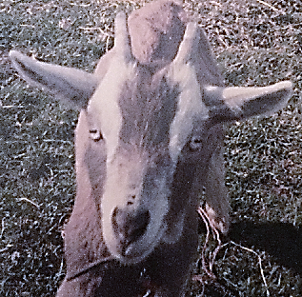
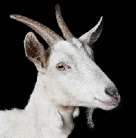
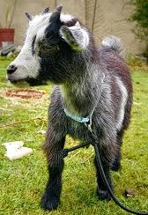
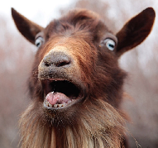
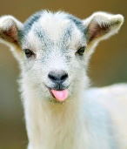
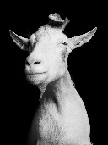
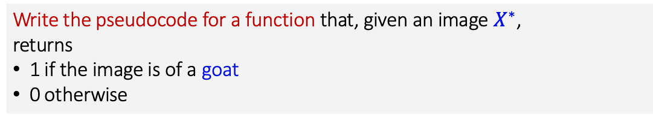
Why ML? Example 3
Write the pseudocode for a function that, given an image $X^{∗}$, returns
1 if the image is of a goat
0 otherwise
How would we write such a function?
What information would make our lives easier?
Data!
This is why we use machine learning.
ML lets us use data to learn (approximate) a particular function.

Slide 17
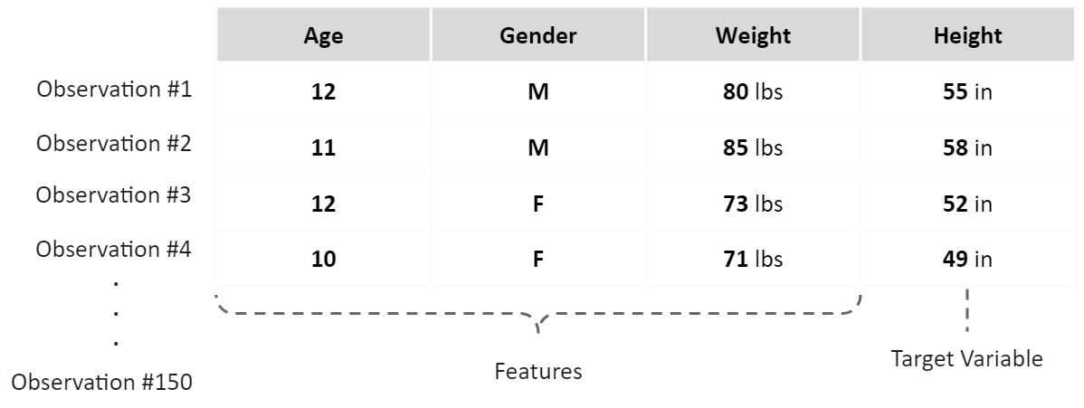
Terms in Machine Learning
Dataset example

Slide 18
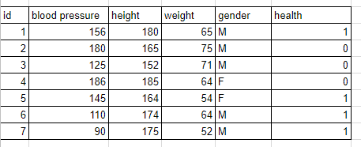
When we train a computer by providing it with data that has predefined outputs, we call this supervised learning. We train the algorithm on a labeled training set and we test it with new data point to make a prediction for us.

Slide 19
Examples of supervised machine learning tasks include:
Determining whether a tumor is benign based on a medical image
Here the input is the image, and the output is whether the tumor is benign. To create a dataset for building a model, you need a database of medical images. You also need an expert opinion, so a doctor needs to look at all of the images and decide which tumors are benign and which are not.
Detecting fraudulent activity in credit card transactions
Here the input is a record of the credit card transaction, and the output is whether it is likely to be fraudulent or not. Assuming that you are the entity distributing the credit cards, collecting a dataset means storing all transactions and recording if a user reports any transaction as fraudulent.

Slide 20
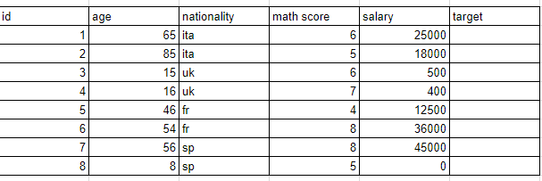
When we simply hand over a dataset to the computer and ask it to find something interesting, this is known as unsupervised learning, since we're not telling the computer what output we'd like to see. We ask the algorithm to group the data for us.

Slide 21
Examples of unsupervised machine learning tasks include:
Identifying topics in a set of blog posts
If you have a large collection of text data, you might want to summarize it and find prevalent themes in it.You might not know beforehand what these topics are, or how many topics there might be. Therefore, there are no known outputs.
Segmenting customers into groups with similar preferences
Given a set of customer records, you might want to identify which customers are similar, and whether there are groups of customers with similar preferences. For a shopping site, these might be “parents,” “bookworms,” or “gamers.” Because you don’t know in advance what these groups might be, or even how many there are, you have no known outputs.

Slide 22
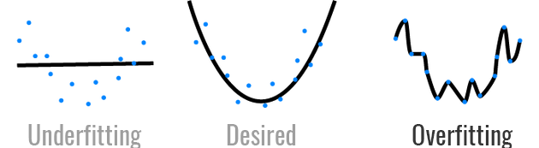
Issues to consider
Your domain knowledge. Understand the task you want the algorithm to solve.
Garbage in - garbage out. Feed the algorithm with relevant data.
Don’t overfit. An overfit model has memorised the noise (i.g. Noise: coming from mistakes in the annotation of the data) in the training set instead of learning the true underlying pattern.

Slide 23
Questions
1. You ask two people to collect information about flowers that you want to classify into 3 species. After a trip in the field they come back with 100 observations each and for each observation with the following annotated features: the length of the petal, the width of the petal, their type of shoes at time of observation, the time of the day, the length of the sepal, the color of the flower, their surname. Are all these features are relevant? Why you would keep some or discard others?
2. What essential information must the two people add to their observations to let you perform supervised machine learning?
3. In another task, you wish to segment flower samples into different groups. Is this a supervised or unsupervised machine learning task? Can it be both?

Slide 24
Answers
1. Their type of shoes at time of observation and their surname seem irrelevant to classify the flowers into 3 species. Moreover, these features can produce a model that would likely make mistakes on unseen data, since if we ask a third person who is the son of the second person to collect the same features from flowers, her/his surname will affect the classification (garbage in garbage out). The time of the day, could be argued to be relevant or not (Domain Knowledge).
2. The essential information that the two people need to insert in their observations to let you perform supervised machine learning is the target label. They must record one of the 3 possible types of flowers that we want to classify.
3. If we haven’t pre-assigned group labels to our dataset then we have an Unsupervised learning problem.

Slide 25
Pipeline in Machine Learning for SUPERVISED LEARNING
Once you've selected your model, you typically follow the same general procedure.
Analyse the Data (Load and check the data)
Define the features X and the target y.
Divide the data into 2 splits one for training and and the other for testing.
Create the machine learning model.
Train your model on the training split.
Evaluate the trained model against the testing split.
Tune all relevant parameters for optimal performance.
Use the final model to make prediction on unseen data.

Slide 26
Coding...
The main goals of this first exercise are:
Explore Jupyter Notebook
See in practice the 8 steps of a Machine Learning Pipeline
The followings slides are a collection of codes that we will see in the practical exercise
There are also cheat sheets in the online folder (we will use most of those pieces of code during the course)

Slide 27






Step 1 (common tools for data analysis)

Slide 28
Step 2 Define the Feature X and target y

Slide 29

Step 3: Divide the data into 2 splits one for training and and the other for testing.

Slide 30
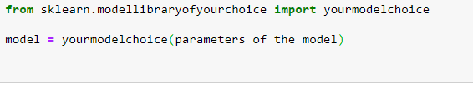
Step 4 Create the Model

Slide 31

Step 5 Train the model

Slide 32
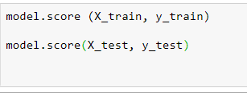
Step 6: Evaluate the model

Slide 33

Step 8 Prediction

Slide 34
PYTHON RESOURCES
How to think like a Computer Scientist in Python
Google's Python class
Documentation
Tutorialpoint (great as a syntax reminder)

